Slide 1
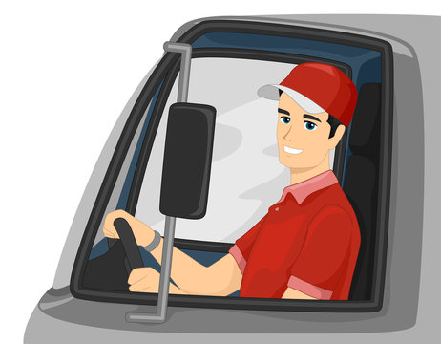
DRIVER DROWSINESS DETECTION AND ALERT SYSTEM
BY:- Abhiram Kumar
Muskan Kumari

Slide 2
INTRODUCTION
The Driver Drowsiness Detection And Alert System is a safety solution that uses computer vision to monitor drivers in real-time. By analyzing facial features and tracking eye movements using OpenCV, the system determines whether the driver's eyes are open or closed. A trained deep learning model helps in this classification. The system keeps a score based on the driver's eye status and triggers an alarm if the score indicates potential drowsiness. This project aims to improve road safety by alerting drivers when they show signs of drowsiness, thereby reducing the risk of accidents. Drowsiness detection technology is a critical safety measure designed to avert accidents caused by drivers experiencing fatigue or falling asleep behind the wheel. Within the framework of this project, we employ sophisticated techniques to identify instances where a person's eyes remain closed for a defined duration, triggering a timely alert to the driver upon detecting drowsiness. Our methodology leverages the power of OpenCV to capture images from a webcam, seamlessly integrating them into a Deep Learning model. This model adeptly classifies the status of the person's eyes, distinguishing between 'Open' and 'Closed' states.

Slide 3
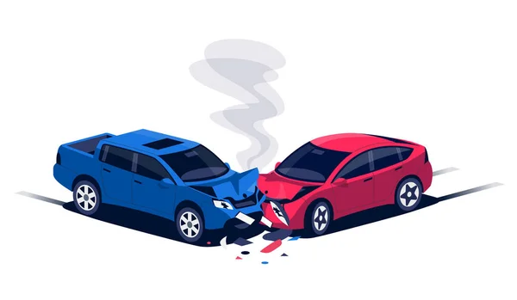
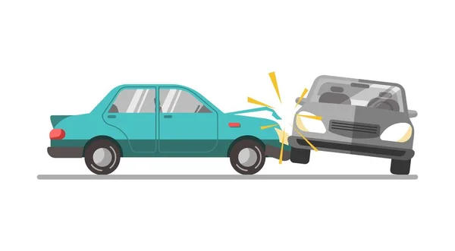
OBECTIVE
We're creating a Driver Drowsiness Detection and Alert System because we want to make roads safer. When drivers get too tired, it can lead to accidents. Our system uses smart technology to recognize when a driver is getting sleepy and sends alerts to keep them awake and focused. Our goal is to prevent accidents, save lives, and make sure everyone stays safe on the road.

Slide 4
Software Requirements Specification
1. Python:
• Python 3
2. Libraries
• Numpy
• Scipy
• Playsound
• Keras
• Imutils
• opencv, etc.
3. Operating System
• Windows or Ubuntu
HARDWARE REQUIREMENTS SPECIFICATION
I. Laptop with basic hardware.
II. Webcam

Slide 5
MOTIVATION
Drowsy driving poses a significant and often underestimated threat on road safety. The consequences of fatigue-related accidents can be severe, leading to injuries, fatalities, and substantial economic losses. The motivation behind the Driver Drowsiness Detection & Alert System project stems from a deep concern for addressing this critical issue and implementing effective solutions to enhance road safety.
Statistics on Accidents Due to Drowsy Driving:
Drowsy driving statistics underscore the gravity of the problem. According to [relevant sources], a substantial percentage of traffic accidents can be attributed to driver fatigue. These incidents often occur during late-night hours or long-distance journeys. The statistics highlight the need for comprehensive measures to mitigate the impact of drowsy driving and prevent potential tragedies
on our roads.

Slide 6
The Need for Technological Interventions:
Traditional approaches to combating drowsy driving, such as regulatory measures and public awareness campaigns, have shown limitations. Technology provides a promising avenue for intervention, offering real-time monitoring and proactive alerts to prevent accidents before they occur. The need for technological interventions arises from the inadequacy of conventional methods in effectively addressing the dynamic and unpredictable nature of driver fatigue.
Importance of Early Detection and Alerts:
Early detection of drowsiness is crucial for preventing accidents. The Driver Drowsiness Detection & Alert System focuses on timely identification of signs of fatigue, leveraging advanced sensor technologies and data analysis. By providing alerts to drivers in the early stages of drowsiness, the system aims to prompt corrective actions, such as taking a break or pulling over, thereby mitigating the risk of accidents. The importance of early detection and alerts cannot be overstated, as it serves as a proactive measure to safeguard both drivers and other road users from the potential dangers associated with drowsy driving.

Slide 7
System Architecture: Driver Drowsiness Detection & Alert System
Overview of the Driver Drowsiness Detection & Alert System:
The Driver Drowsiness Detection & Alert System is designed to enhance road safety by actively monitoring the driver's state and providing timely alerts in case of drowsiness. The system employs a sophisticated combination of hardware and software components, creating an intelligent and responsive framework for detecting signs of fatigue during driving.
Components and Their Functions:
Sensors:
Camera(s): Captures real-time images or videos of the driver's face.
Accelerometer and Gyroscope: Measures vehicle movements and driver's head position.
Biometric Sensors: Monitor physiological parameters such as heart rate and skin conductance.

Slide 8
2.Data Processing Unit:
Microcontroller or Microprocessor: Receives and processes data from sensors.
Signal Processing Algorithms: Analyzes facial expressions, head movements, and biometric data to identify signs of drowsiness.
Machine Learning Models: Trained to recognize patterns associated with driver fatigue.
3.Alert Generation System:
Visual Alerts: LED display or visual cues on the dashboard to attract the driver's attention.
Auditory Alerts: Alarms or spoken messages to alert the driver.
Haptic Feedback: Vibrations or tactile signals through the steering wheel or seat.

Slide 9
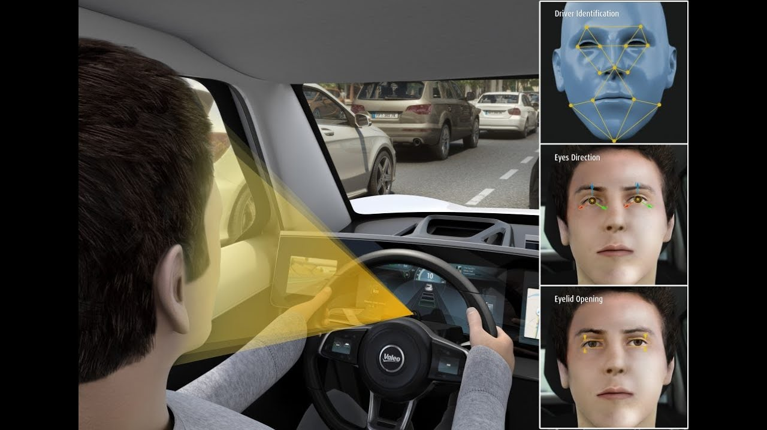
EYE CAPTURING IMAGES

Slide 10
Conclusion
The culmination of the Driver Drowsiness & Alert System project marks a significant stride towards enhancing road safety and mitigating the risks associated with drowsy driving. Through the integration of advanced sensor technologies, intelligent algorithms, and a responsive alert system, the project has successfully addressed the critical issue of driver fatigue on our roads.
Key Achievements:
Early Detection and Timely Alerts:
The system excels in early detection of drowsiness, leveraging a multi-sensor approach to monitor various aspects of driver behavior.
Timely alerts, including visual, auditory, and haptic cues, have been implemented to prompt corrective actions and prevent potential accidents.
Robust Sensor Integration:
The project effectively integrated diverse sensors such as cameras, accelerometers, gyroscope, and biometric sensors, ensuring a comprehensive assessment of the driver's condition.
Multi-sensor fusion techniques were employed to maximize the accuracy and reliability of drowsiness detection.
Customizable User Interface:
A user-friendly interface has been developed, providing drivers with real-time information about their alertness level and allowing customization of alert preferences.
The interface enhances user engagement and ensures the system's seamless integration into the driving experience.
Validation and Iterative Improvement:
Rigorous testing and validation processes were conducted in both controlled environments and real-world driving scenarios.
User feedback has been instrumental in identifying areas for improvement, leading to iterative enhancements for better performance.
Contributions to Road Safety:
The Driver Drowsiness & Alert System significantly contributes to road safety by addressing a key factor in traffic accidents—driver fatigue.
The proactive approach to drowsiness detection aligns with broader efforts to reduce accidents, injuries, and fatalities on the road.

Slide 11
Future Directions:
Integration with Autonomous Vehicles:
Explore opportunities for integration with autonomous driving systems to bolster overall vehicle safety.
Collaboration with Manufacturers:
Seek collaborations with automotive manufacturers to integrate the system into upcoming vehicle models.
Continuous Improvement:
Establish a framework for ongoing improvement, incorporating emerging sensor technologies and refining algorithms based on evolving research.
Regulatory Considerations:
Work towards standardization and compliance with regulatory guidelines for in-vehicle safety systems.
In conclusion, the Driver Drowsiness & Alert System project not only marks a successful implementation but also serves as a commitment to ongoing innovation and the pursuit of a safer transportation landscape. With its potential to significantly reduce accidents attributed to driver fatigue, the project stands as a testament to the power of technology in advancing road safety. The journey doesn't end here; it signifies a new beginning, where continuous improvement and collaboration will pave the way for safer and more secure roads for all.

Slide 12
THANK YOU!!

